Slide 1
The business case
Is it worth doing, and what would change my mind?
Applied AI and Automation | Session 11 of 12
KLAi Professional Learning | Jotham Martin Wambi
Notes:
Welcome to Session 11. If you wrote down a first-year cost after Session 10, read it out. Today you work it out properly. We cost one task at Nile Valley Foods, then a second example, the invoice check, where a formula can beat an AI. Then you cost your own task and write down what would change your mind. Your first numbers are estimates, and that is fine.

Slide 2



Today in one view: what you will leave with
By the end of today you will have
A costed business case for your own task, starting from your Session 1 baseline
A payback, a 12-month net, a risk haircut and a low, base and high view
What would stop the project, written as numbers, and a one-page summary the owner of the business can decide from
Notes:
Here is what you leave with. A costed workbook for your own task, starting from your Session 1 baseline, with payback and a twelve month net. A haircut for risk and a low, base and high view. What would stop the project, written as numbers. And a one-page summary that the owner of the business can decide from in two minutes. Forty-five of today’s minutes are yours.

Slide 3
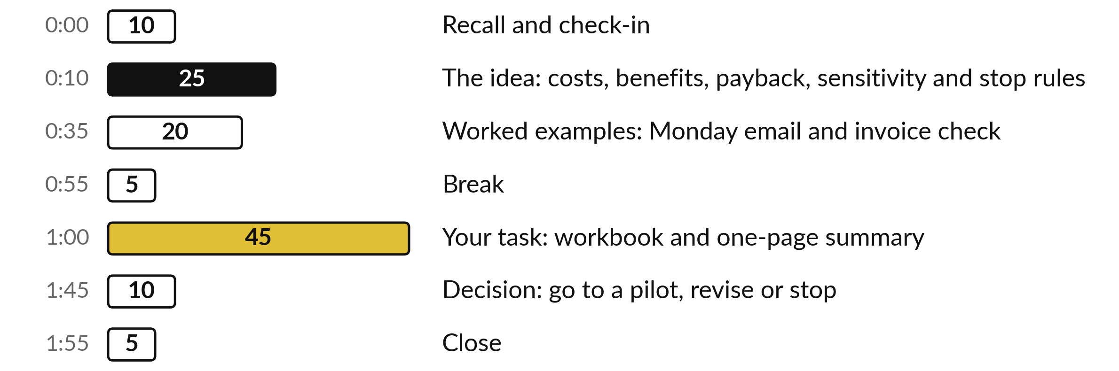
Your two hours: 45 minutes are your own work
45 of the 120 minutes are yours: your numbers, your costs, your decision.
Notes:
Three parts take most of the time. Twenty-five minutes of ideas on costs, benefits, payback, sensitivity and stop rules. Twenty minutes of worked examples: the Monday sales email at Nile Valley Foods, the customer message workflow from Session 8, and the invoice check. After the break you have forty-five minutes on your own task, in three blocks of fifteen. The last ten minutes are for your decision.

Slide 4

Three questions from last time
1. Name three of the five oversight controls for a tool you buy.
2. On the Vendor Question List, what does a 0 in data and privacy, security, or contract and exit mean?
3. How many of the 11 planted red flags did the two AI reviews catch, and what did you still have to do?
Answer aloud first. Then we check together.
Notes:
Three quick questions from Session 10. Answer aloud first, and then we check together. It is a warm-up to bring last time back.
Question one. Name three of the five oversight controls for a tool you buy. Take a moment.
A good answer is this. Any three of: data location, terms, exit, audit, owner.
Question two. On the Vendor Question List, what does a 0 in data and privacy, security, or contract and exit mean? Say it to yourself first.
A good answer is this. It is a reason to stop. A 0 is a red flag, a refusal or silence.
Question three. How many of the 11 planted red flags did the two AI reviews catch, and what did you still have to do? Think about your own task as you answer.
A good answer is this. Both runs caught all 11. You still check its quotes, send the questions and judge the vendor’s written answers.
If an answer was missing, your own task card or last workbook page has it. Now to today.

Slide 5




Words we use today
Word | What it means
Payback | The number of months the monthly net takes to repay the one-off cost.
Loaded hourly cost | Pay plus employer contributions and benefits, divided by hours worked. It is what an hour of staff time costs the company.
Haircut | The share of the benefit you choose not to count, because estimates are rarely exact.
Sensitivity | Trying a low, base and high version of your numbers to see whether the answer changes.
Stop rule | A number written in advance that tells you to stop or revise.
Notes:
Five words for today. I give the plain meaning of each, and we use every one of them before the end of the session.
Payback. The number of months the monthly net takes to repay the one-off cost.
Loaded hourly cost. Pay plus employer contributions and benefits, divided by hours worked. It is what an hour of staff time costs the company.
Haircut. The share of the benefit you choose not to count, because estimates are rarely exact.
Sensitivity. Trying a low, base and high version of your numbers to see whether the answer changes.
Stop rule. A number written in advance that tells you to stop or revise.

Slide 6
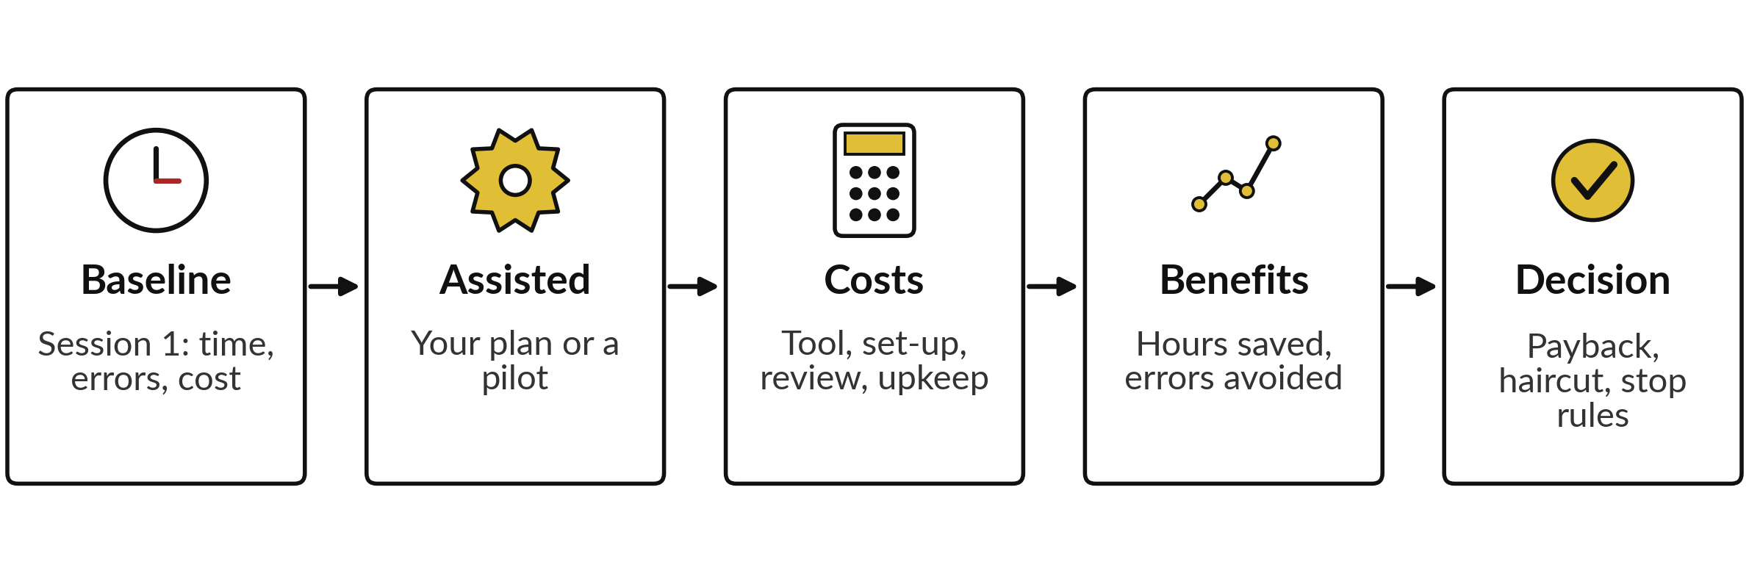
A business case puts money on your baseline
You hold the first step already. Today you add the money.
Notes:
Today’s question is whether a task is worth doing and what would change your mind. A business case takes the baseline you wrote in Session 1 and puts money on both sides: costs, then benefits, then payback, a haircut for risk and stop rules. Why bother?
Gartner forecast in June 2025 that over forty percent of agentic AI projects will be cancelled by the end of 2027, mainly because of rising cost, unclear value and weak risk controls. A short, honest case is your answer to it. Ask me for the reference. Tell me now which number you are least sure of.

Slide 7







The Session 1 baseline is the
number the business case must beat
Field | Monday sales email at Nile Valley Foods | E or M
Time today | 90 minutes, one person | E
Volume | 4 emails a month | M
Hours a month | 4 x 90 minutes = 6 hours | E
Usual errors | Wrong week or mistyped figures in 4 emails out of 10 | E
Cost of one error | About UGX 150,000 | E
What better means | Draft in 10 minutes, checked in 20 | E
Hourly cost | UGX 4,500,000 + 500,000 over 160 hours, about UGX 31,250 | E
E means estimate. M means measured: someone timed or counted it. The workbook rounds the hour to UGX 30,000, an invented NVF figure.
Notes:
This is the finished task card from Session 1, with the letters that tell you how solid each number is. Ninety minutes a run, four runs a month, so six hours a month. Mistakes in four emails out of ten, and one mistake costs about one hundred and fifty thousand shillings.
Better means a draft in ten minutes and a check in twenty. For the hourly cost, pay of four and a half million plus employer contributions of half a million, over one hundred and sixty hours, is about thirty-one thousand shillings. The workbook rounds it to thirty thousand.
In the workbook, the ten minutes becomes the minutes with the tool, and the twenty is the review. Notice that most numbers are estimates, and that is acceptable if you say so.

Slide 8






Five cost lines, and review time never goes away
Cost line | Kind | NVF amount (UGX)
Tool licence | Monthly | 60,000 (invented)
Set-up and data preparation, 12 hours | One-off | 360,000
Training, 4 hours | One-off | 120,000
Review, 4 runs of 20 minutes | Monthly | 40,000
Upkeep, 1.5 hours | Monthly | 45,000
Total | Once and monthly | 480,000 once; 145,000 a month
Hours cost UGX 30,000 each (invented NVF figure). The licence is an invented example for the arithmetic. If you buy, use the vendor’s first-year total.
Notes:
These are the cost lines in the workbook, with the Nile Valley Foods figures. The tool licence is monthly, and the figure is an invented example, so use your own quote. Set-up and data preparation happen once: building it, testing it and tidying the data it reads. Training happens once.
Review time repeats every month, four runs of twenty minutes, and it never goes away, so never set it to zero. Upkeep is the time to fix and update. The total is UGX 480,000 once and UGX 145,000 each month. If you buy or partner, put the vendor’s first-year total in these lines.

Slide 9
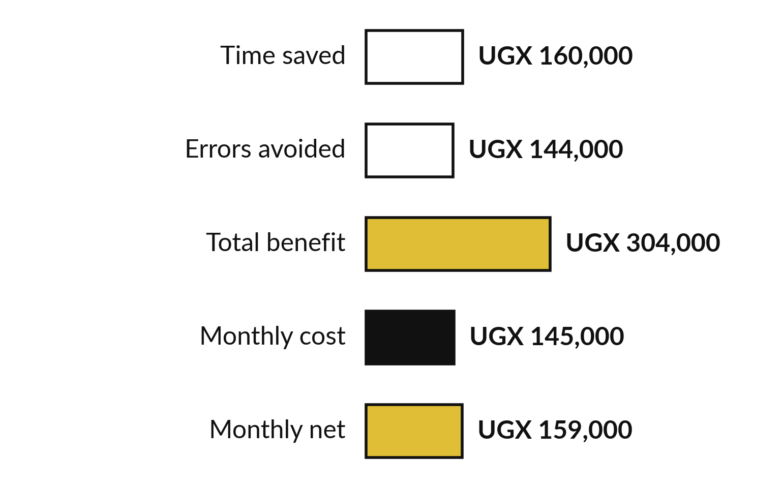
Benefits: count hours and
errors, and write down the rest
Count hours and errors. Count other benefits at zero.
Hours: 4 runs x 80 minutes x UGX 30,000 an hour.
Errors: 4 runs x 40% x 60% removed x UGX 150,000.
Faster replies: write it, count 0.
Notes:
Benefits come from your baseline and your plan. Time saved is the runs a month, times the minutes saved before review, times the hourly cost. At Nile Valley Foods that is four runs times eighty minutes, which is 5.3 hours, at UGX 30,000 an hour: UGX 160,000 a month.
The eighty is ninety minutes today less the ten minutes of your own work with the tool. Errors avoided is runs, times the error rate, times the share removed, times the cost of one error: UGX 144,000. The sixty percent removed is a plan, so mark it as an estimate.
Goodwill is real, but I count it at zero unless you can show a number. Benefit of 304,000 less cost of 145,000 leaves a net of UGX 159,000 a month.

Slide 10
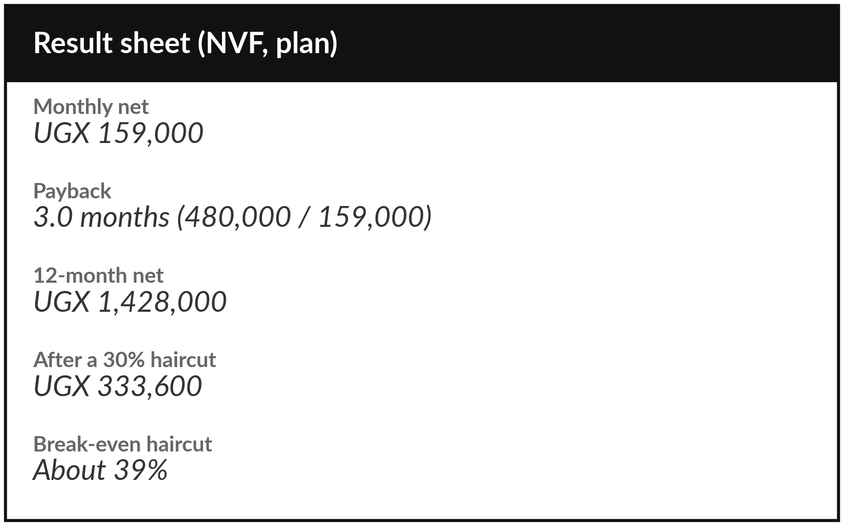
On plan, the Monday email
pays back in 3.0 months
The haircut shows how much of the benefit can vanish.
These are plan numbers.
Positive until about 39% of the benefit fails to appear.
Measure in a pilot before you trust it.
Notes:
Here is the result. A monthly net of UGX 159,000. The one-off cost of UGX 480,000 divided by 159,000 is 3.0 months to pay back. Twelve months net of the one-off cost is UGX 1,428,000. Then the haircut: I choose not to count thirty percent of the benefit, and the twelve month net is still UGX 333,600.
The break-even haircut is about thirty-nine percent, which means more than a third of the benefit can fail to appear before the case reaches zero. These are plan numbers, built from estimates. A pilot replaces them with measured numbers.

Slide 11



Low, base and high: NVF is positive
in two cases and negative in one
Scenario | What changes | Monthly net | Payback | 12-month net
Low | Volume 70%, saving 60%, errors avoided 40%, costs 30% higher | UGX -80,980 | No payback | UGX -1,595,760
Base | The numbers on your Inputs sheet | UGX 159,000 | 3.0 months | UGX 1,428,000
High | Volume 110%, saving 120%, errors 120%, costs 10% lower | UGX 270,780 | 1.6 months | UGX 2,817,360
A case that is positive in only two of three scenarios needs a stop rule for the low case.
Notes:
This is the Sensitivity sheet with the workbook’s default factors. The monthly net is minus UGX 80,980 in the low case, UGX 159,000 in the base case and UGX 270,780 in the high case. In the low case volume is seventy percent, only sixty percent of the saving happens, only forty percent of the errors are removed, and costs are thirty percent higher.
The result is no payback. The haircut shrinks the benefit, and sensitivity changes the assumptions, so I use both. Nile Valley Foods is positive in two of three cases, so I ask what would have to be true in the low case, and I write it as a stop rule.

Slide 12


What would stop the project: write
it as numbers before you start
Stop if one error reaches a customer or the bank, until the cause is fixed.
Revise if review minutes rise above 30 a run.
Revise if the 12-month net after the haircut turns negative.
Stop if the saving is under half the plan after four weeks.
Scale only after the base case holds for two months.
Notes:
What would change my mind?
Write it down now, while you are calm. These are example rules for Nile Valley Foods. Stop if one error reaches a customer or the bank. Revise if review minutes climb above thirty a run. Revise if the twelve month net after the haircut turns negative. Stop if the saving after four weeks is under half the plan.
Scale only after the base case holds for two months. Each rule is a number somebody can check. In Session 12 these become part of your ninety day plan, so choose numbers you can read from your own records.

Slide 13


For the Session 8 message workflow, the
minutes a person still spends decide it
Person minutes a day with the workflow | Person hours a month | Saving a month | Net after running costs | Payback
15 | 5.0 | UGX 300,000 | UGX 195,000 | 2.5 months
25 | 8.3 | UGX 200,000 | UGX 95,000 | 5.1 months
35 | 11.7 | UGX 100,000 | UGX -5,000 | No payback
All invented: 45 minutes a day (Session 1 example row), 20 days a month, UGX 30,000 an hour, 105,000 running, 480,000 once.
Notes:
The same five lines work for the message workflow from Session 8. Every figure here is invented for the arithmetic, including the forty-five minutes a day, which is only an example row on the Session 1 practice slide. Session 8 did not measure how long the person needs with the workflow, so I vary it.
The others: twenty days a month, thirty thousand shillings an hour, and running costs of one hundred and five thousand a month, which is the licence of sixty thousand plus upkeep of forty-five thousand. The person’s minutes are the column I vary. If the person still needs fifteen minutes a day, the net is UGX 195,000 a month.
At thirty-five minutes a day, the net is below zero. The lesson is the minutes the person still spends. Time them for your own task.

Slide 14
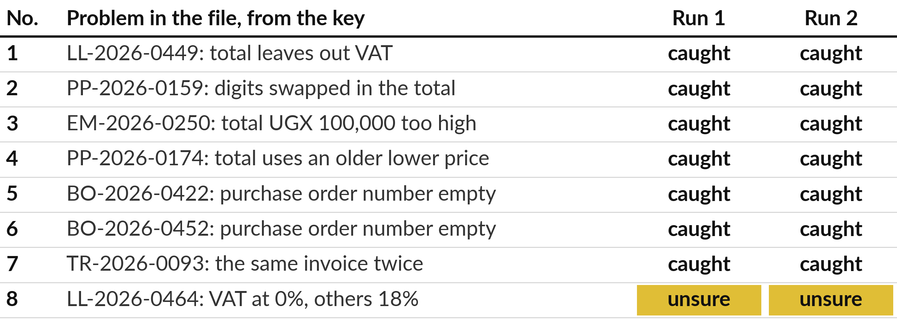
The AI found all 8 invoice problems in both runs
Claude, a fresh session given only the prompt, 4 November 2026, answer key hidden. Two runs.
Notes:
Now a second example, the invoice check. I gave sixty supplier invoices to Claude in two fresh sessions, each given only the prompt, and asked for duplicates, missing purchase order numbers and totals that do not add up. This was Claude on the fourth of November 2026, not ChatGPT or Gemini, with the key hidden.
Both runs found all eight problems and raised no false alarm. On the zero percent VAT invoice, both said they were unsure and told us to ask the supplier. Both said they did the sums without code, which is their own statement. Run two also said dates and PO numbers were in sequence, which is not quite true. I recomputed all sixty rows: the eight are the only problems.

Slide 15



Recomputed: the value of an invoice and
the error in its total are different sums
Problem | Invoice | Invoice total in the file | Error in the total
Duplicate: pay it once | TR-2026-0093 | 13,973,560 | None; pay it once
No purchase order number | BO-2026-0452 | 14,610,760 | None; hold it
No purchase order number | BO-2026-0422 | 4,307,000 | None; hold it
VAT at 0% instead of 18% | LL-2026-0464 | 4,550,000 | 819,000 lower
VAT left out of the total | LL-2026-0449 | 2,400,000 | 432,000 short
Total too high | EM-2026-0250 | 14,732,000 | 100,000 over
Total uses an older price | PP-2026-0174 | 371,700 | 5,900 short
Digits swapped | PP-2026-0159 | 973,050 | 450 short
UGX. Missing-PO invoices are held, not lost. Both runs listed the problems by type.
Notes:
I recomputed each of the eight problems from the invoice file. Two different sums sit in this table. The duplicate invoice is for UGX 13,973,560, which would be paid twice. The two invoices with no purchase order number are for UGX 14,610,760 and UGX 4,307,000, and their amounts are correct: they are held until a purchase order is found, not lost.
The zero percent VAT invoice is 819,000 shillings lower than at eighteen percent. The four wrong totals are off by 432,000 down to just 450 shillings. Both runs listed the problems by type, so the 450 shilling slip sat next to a thirteen million duplicate. A person decides what to chase first.
Which of your own checks has a small error and a big one side by side?

Slide 16



Every check costs time, and only a formula
can promise the same sums every run
Route | Who does the sums | What you still do | Trust the rest?
By hand | You | All 60 rows, one by one | Only if you stay careful
AI, then a person | The AI, working the sums in text | Confirm 8 flags | Redo the rest (about 51 invoices)
Formula, then a person | The sheet, every row | Judge the flagged rows | Yes, once the formula is tested
Time each route on your own task. The 120 minutes by hand is an invented example row on the Session 1 practice slide.
Notes:
Here is the lesson for your business case. Every check costs time. With the AI route you confirm the eight flags against the invoices, and then you face a choice about the other fifty-one invoices it passed. Both runs said everything else matched, and that was true here, but you only know it if you redo the sums, and a formula does exactly that.
A formula in the sheet checks every row the same way every run, and it flags a missing purchase order or a duplicate. It cannot judge the zero percent VAT, so a person still does that. In your workbook, the formula route has set-up hours and almost no review minutes.

Slide 17
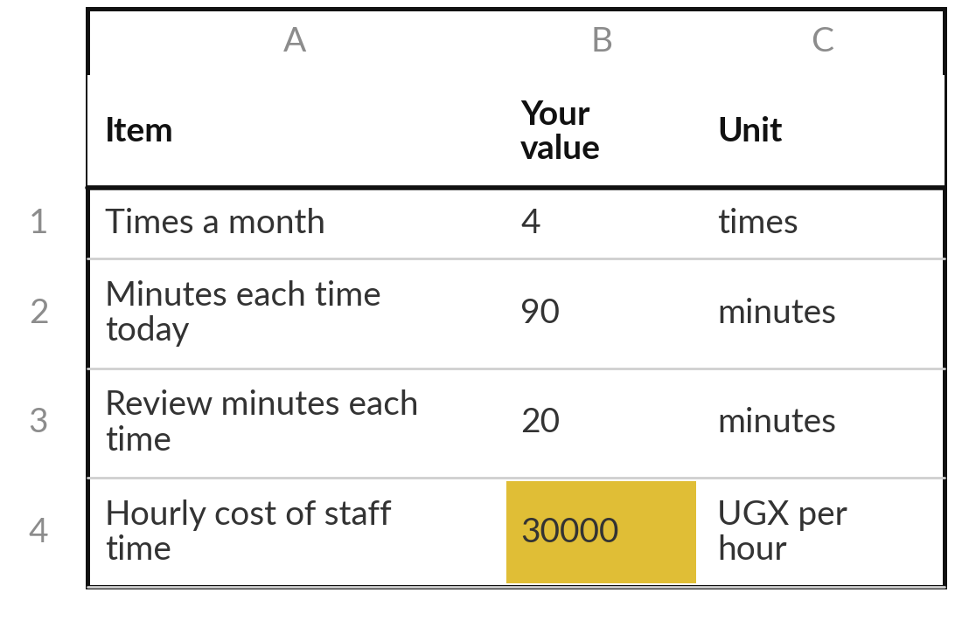
Practice: enter your baseline and your costs
15 minutes
Your own company task
Fill Inputs and Costs in your own Business Case Workbook.
Open Business Case Workbook.xlsx. Type your Task Card numbers over the grey ones.
Work out your hourly cost: pay plus employer contributions and benefits, over hours worked.
Fill every cost line. If you buy, use the vendor’s first-year total.
Mark plan numbers E. Keep review above zero. Errors removed is a plan: be cautious.
You keep: Inputs and Costs sheets filled with your own numbers.
Notes:
Take fifteen minutes. Open the Business Case Workbook and type your own numbers over the grey ones. Take the minutes by hand, the volume, the error rate and the cost of one error from your Task Card. Your minutes with the tool are a plan, so mark them as estimates until a pilot measures them.
For your loaded hourly cost, add employer contributions and benefits to monthly pay and divide by hours worked. Then fill every cost line. If you chose to buy or partner, use the vendor’s first-year total from last session. I will walk round. Ask me when a number is an estimate.

Slide 18
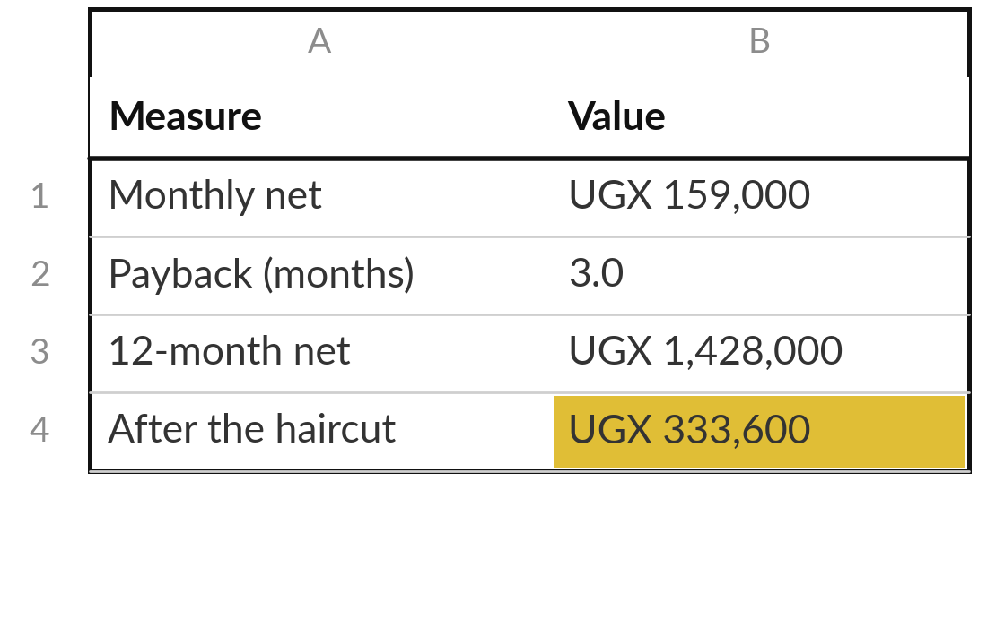
Practice: read the result and test three cases
15 minutes
Your own company task
Finish Benefits, Result and Sensitivity.
Check Benefits: hours saved and errors avoided. Leave other benefits at 0.
On Result, type a haircut. Note the payback and the break-even.
On Sensitivity, adjust the low, base and high factors.
Check that the Base column matches the Result sheet.
You keep: Payback, a haircut result and three cases for your own task.
Notes:
Another fifteen minutes. Check the Benefits sheet. Hours saved and errors avoided come from your inputs. Leave other benefits at zero unless you can show a number. On the Result sheet, choose a haircut and write down the payback, the twelve month net after the haircut and the break-even haircut.
Then go to Sensitivity and adjust the factors to suit your task. The Base column must match the Result sheet. If your low case is negative, say so plainly. That is a useful finding, because it tells you which number to guard.

Slide 19
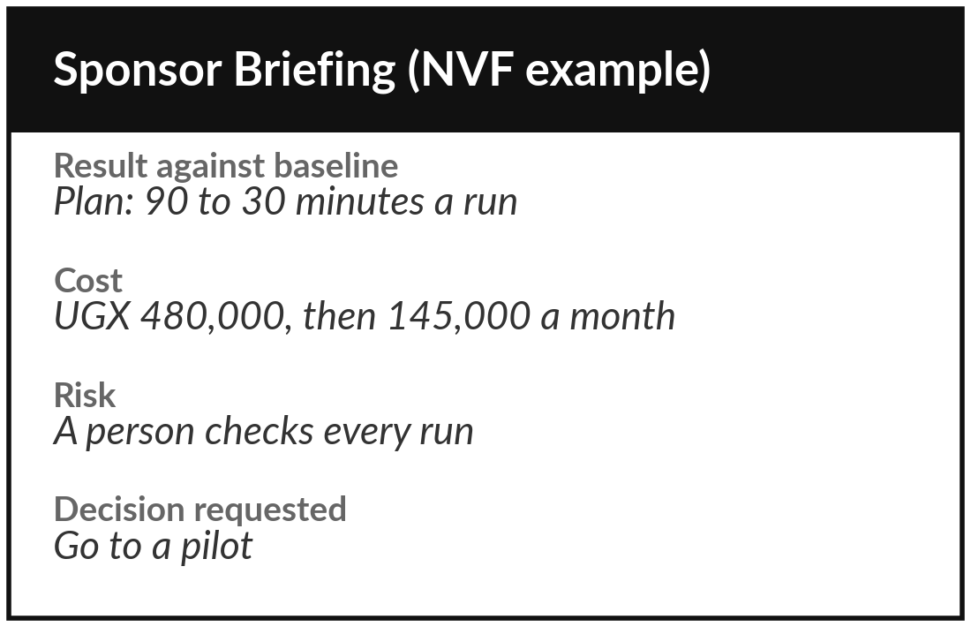
Practice: write what would stop
it, then the one-page summary
15 minutes
Your own company task
Write three stop rules, then fill Sponsor Briefing.docx.
Write three stop rules as numbers you can check.
Name your sponsor: the person who owns the result and asks for the decision.
Fill result against baseline, cost and risk. Label planned numbers as plan.
Write the decision you ask for in one sentence.
You keep: A one-page summary: result, cost, risk, stop rules and the decision requested.
Notes:
The last fifteen minutes of your own work. First write three stop rules, as numbers somebody can check. Then open the Sponsor Briefing. A sponsor is the person who owns the result and asks for the decision. In a small company that may be you, and the page goes to the owner of the business or the board.
Fill it in with your planned numbers and label them as plan. After a pilot you replace them with measured numbers. Write one sentence that says what you want decided. Read it aloud. If it takes more than two minutes, cut it.

Slide 20



Decision: go to a pilot, revise or stop?
What do you decide, and which number decided it?
Go to a pilot
Revise
Stop
Positive after the haircut and in at least two cases. Start a limited pilot with a review date.
Positive only in the base case. Fix the weakest number: review time, error cost or price.
Negative after the haircut and in every case. Keep the workbook and retest when a number changes.
Write the decision and the one number that decided it on the summary page.
Notes:
Time to decide. Go to a pilot means the case is positive after the haircut and in at least two of the three cases. Your numbers are still plan numbers, so the next step is a limited pilot with a review date, which gives you measured numbers. Revise means it is positive only in the base case, so fix the weakest number: review time, error cost or the tool price.
Stop means it is negative after the haircut, so keep the workbook and test again when a number changes. A stop with a clear reason also saves money. Write your decision and the one number that decided it.

Slide 21
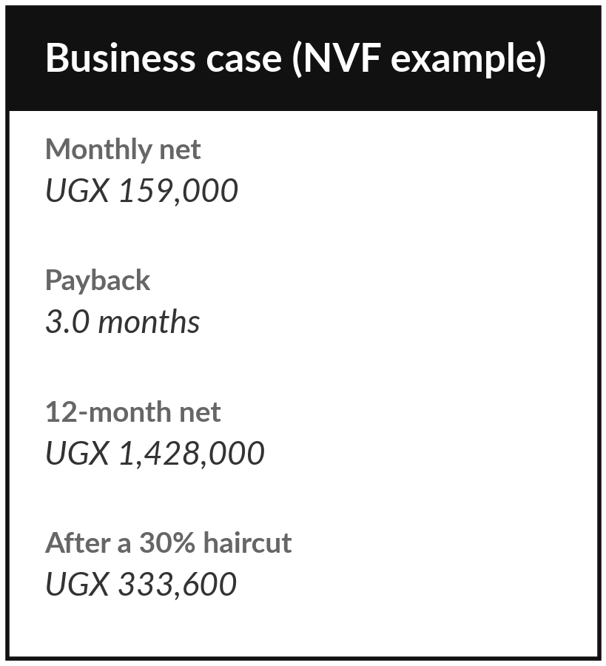
Save the workbook and the summary page
What you keep from today
Your costed Business Case Workbook and a one-page Sponsor Briefing, with your go to a pilot, revise or stop decision and the number that decided it.
Our question today
Is it worth doing, and what would change my mind?
Next session
Session 12: Your data roadmap and 90-day plan. You will turn your Session 4 assessment into a roadmap with owners and dates.
Notes:
Save the workbook and the summary page in the same folder as your task card, your policy draft and your oversight card. Next session you turn your Session 4 assessment into a data roadmap and a 90-day plan, so bring the workbook. Optional, if you want a head start: write down the one number that would make your sponsor say yes or no. That number is the first line of your 90-day plan.
We began with this question: Is it worth doing, and what would change my mind? Before you go, say in one sentence what you can now say about it.

